Slide 1

Laptop Price Prediction
Bhavana Balasa
S9322

Slide 2


TABLE OF
CONTENTS
01
Introduction
02
ML Model Phases
03
Conclusion

Slide 3

01
INTRODUCTION

Slide 4


Problem Statement
To develop a robust machine learning model that predicts laptop prices accurately. Having a precise pricing model becomes crucial for both consumers and manufacturers.

Slide 5








02. ML Model Phases
Data Understanding
Data Cleaning
Feature Extraction
EDA
DataWrangling&Selection
Modeling&Deployment

Slide 6
Data Understanding
Company, TypeName, Inches, ScreenResolution, Cpu, Ram, Memory, Gpu, OpSys, Weight, and Price are provided columns.
Understand what each column is informing.
Decide the target/Dependent and Independent variables.
The type of ML used depends on the target variable.

Slide 7
Data Cleaning
Remove the unnecessary columns, as your data contains 'Unnamed: 0’, and 'Unnamed: 0.1’.
Empty rows are removed.
Replaced the wrong values by checking every column and replacing them using the multivariate imputation technique.
Checked the missing values.
Duplicates are removed.
Detecting and Handling the outliers are done using the Boxplot IQR method.

Slide 8
Feature Extraction
Extract meaningful features to enhance model performance.
Consider creating new features that capture the essence of laptop pricing.
To improve the performance of the model extracted features should be non-redundant and provide a strong relationship with the target variable.

Slide 9
Exploratory Data Analysis(EDA)
EDA (Exploratory Data Analysis) in machine learning is the process of examining and summarizing a dataset to uncover patterns, detect anomalies, and gain insights that inform model-building decisions.

Slide 10
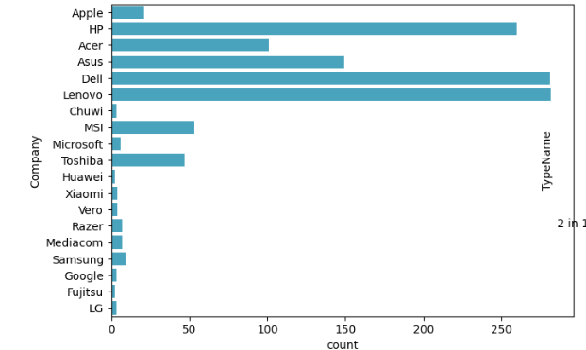
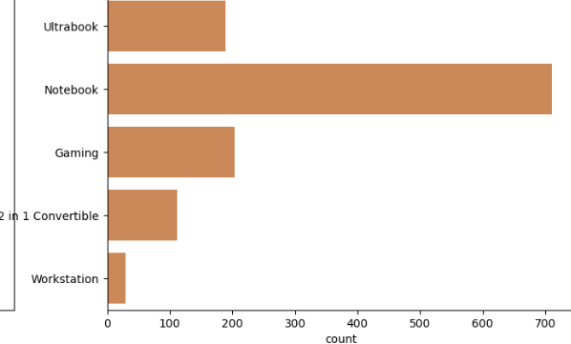
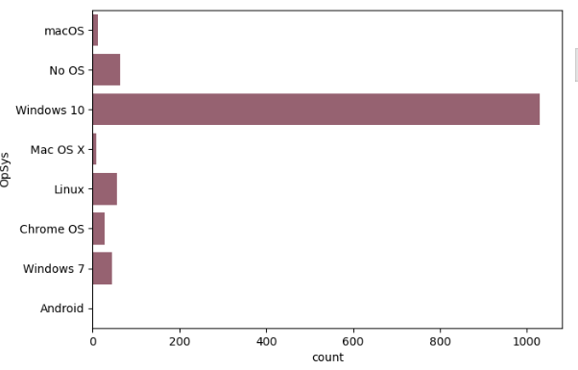
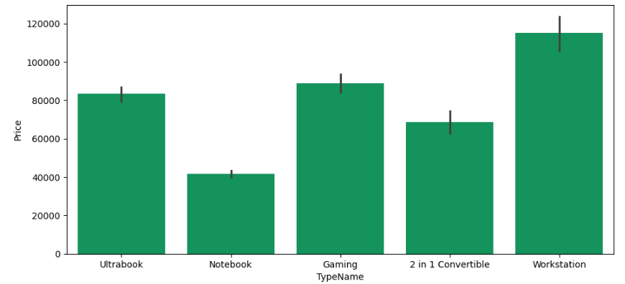

Slide 11
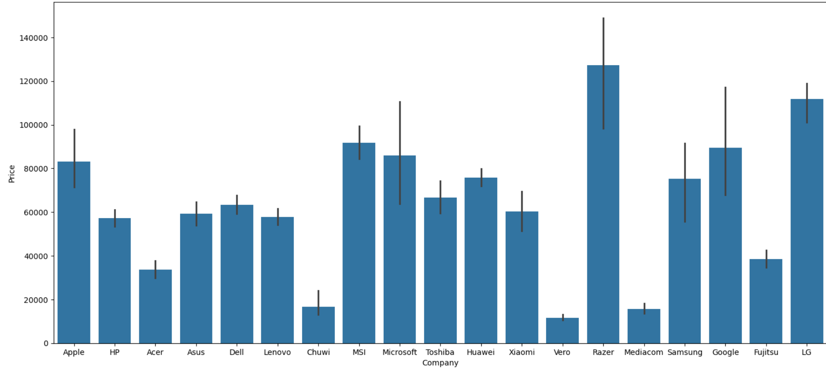

Slide 12
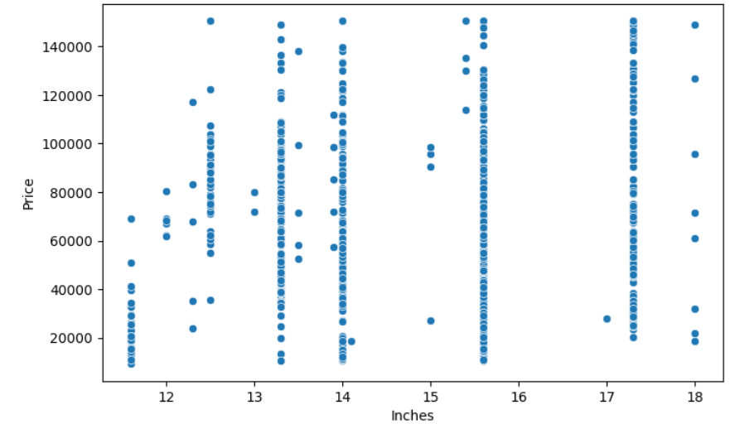
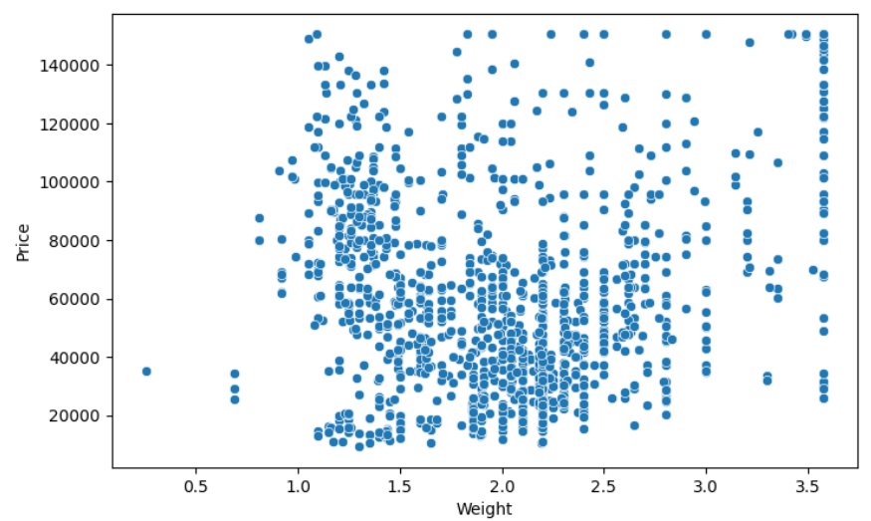
There isn’t a clear linear relationship between size and price.
A particular size (e.g., 14 inches) has both high and low prices, depending on other factors like product features, quality, or brand.
There is no clear linear relationship between Weight and Price.
Prices remain spread across the range of weights, suggesting weight does not strongly determine the price.

Slide 13
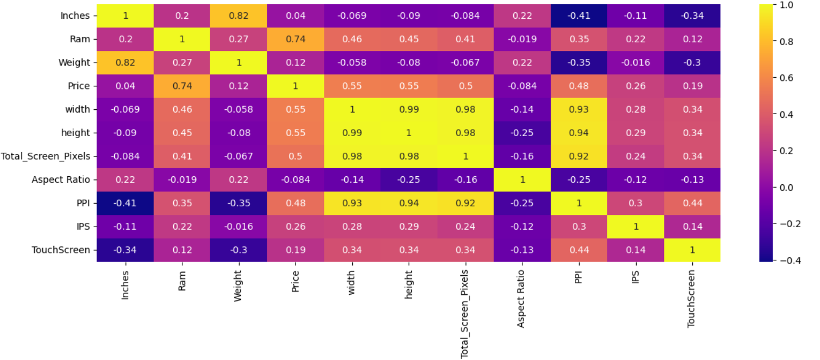

Slide 14
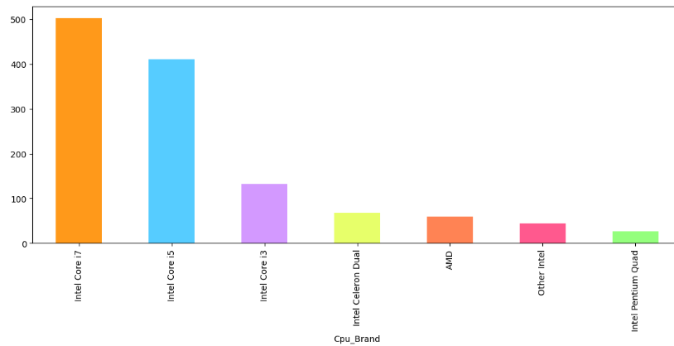
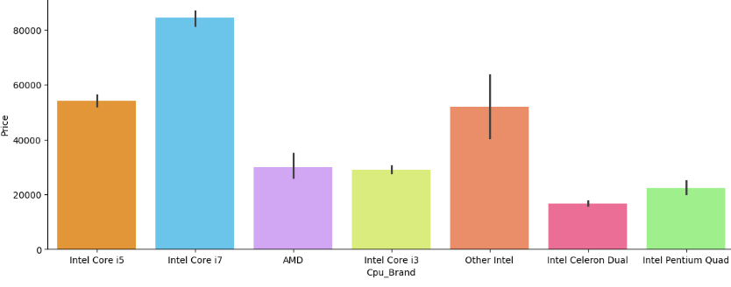
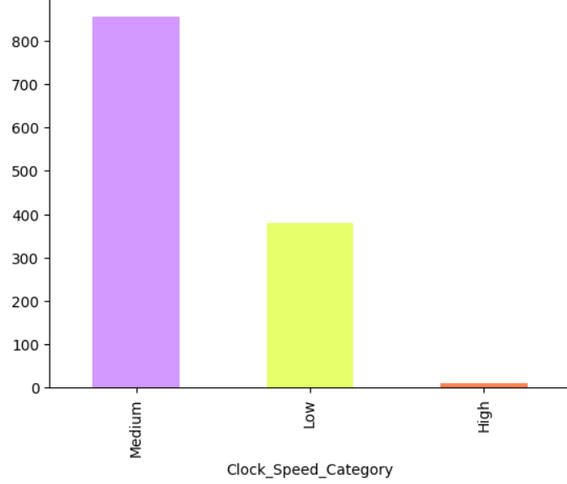
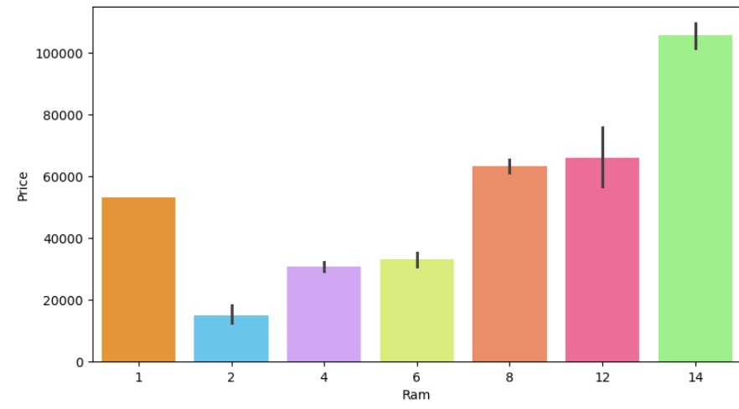

Slide 15
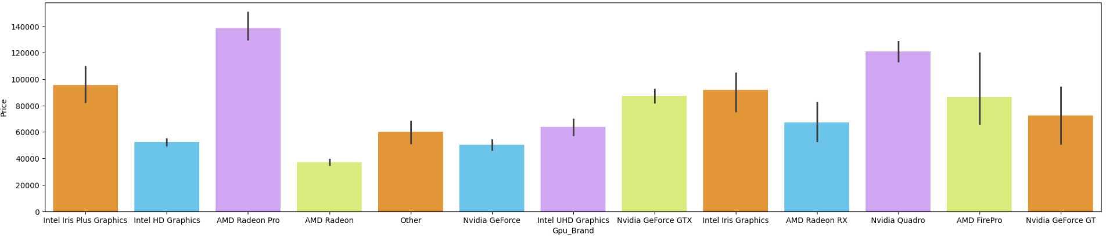
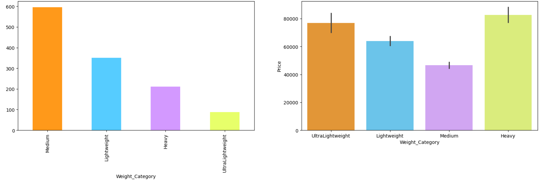

Slide 16
Data Wrangling & Feature Selection
Based on the feature selection the columns remained are Company, typename, Ram, Price, PPI, cpu_brand, Clock_Speed_Category, SSD, Gpu_Brand, Op_Sys, and Weight_Category.
Encoding: DummyEncoding for Company, TypeName, Cpu_Brand, Gpu_Brand, Op_Sys and Ordinalencoding for Clock_Speed_Category, Weight_Category.
Feature scaling: Used StandarScaling for Ram, PPI, SSD.
Feature transforming: Applied Log Transformation on price as it is right skewed.

Slide 17
Modeling
Split the Data
X=Independent Varaibles
Y=Dependent variable
train_test_split:
Train Data -80%
Test Data – 20%
Apply Regression Models.

Slide 18
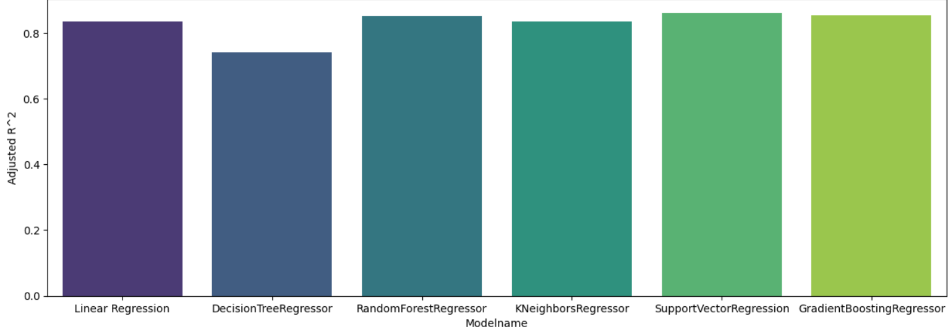
83.6
85.0
83.5
86.0
85.4
74.1

Slide 19
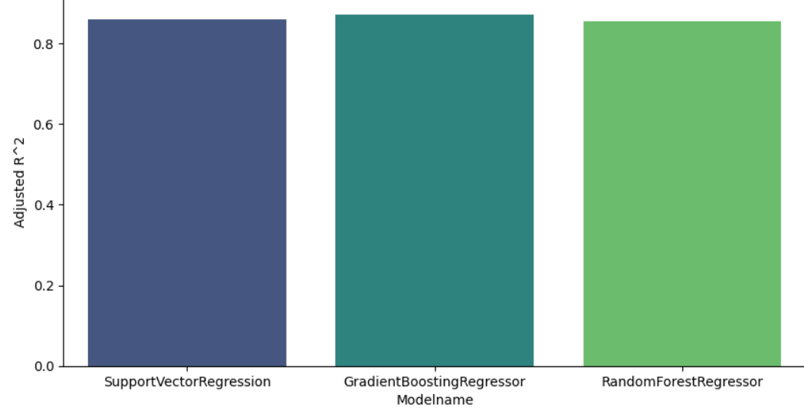
Hyper Parameter Tunning
86.0
87.1
85.5

Slide 20
Deployment
After building a machine learning (ML) model, the next step is to deploy and integrate it into real-world data to make it useful in practical applications.
Pipeline: In machine learning, a Pipeline is a tool that helps streamline and automate the process of applying multiple steps (like preprocessing, feature engineering, and modeling) in a consistent and reproducible manner. It encapsulates the entire workflow into a single object, which can be used for training, validation, and prediction tasks.
Joblib is a Python library used primarily for saving (serializing) and loading (deserializing) machine learning models

Slide 21
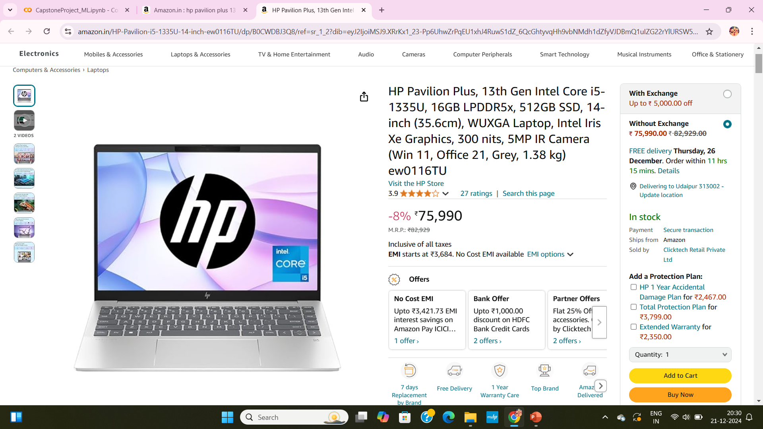
Real Example: Mean Absolute Error (MAE): 0.03

Slide 22
Conclusion:
Company, typename, Ram, Price, PPI, cpu_brand, SSD, and Gpu_Brand are features that have the most significant impact on laptop prices.
Predicting laptop prices for lesser-known brands can be challenging for an ML model with a lack of Training Data for Lesser-known brands.
Missing, incomplete, or outdated data can affect model accuracy.
Budget laptops may dominate the dataset, leading to the underrepresentation of high-end or niche models.
Predicting the prices of newly released laptops not present in the training dataset is challenging because the model has no prior exposure to these configurations, features, or pricing strategies.

Slide 23
Thank
You

